Slide 1
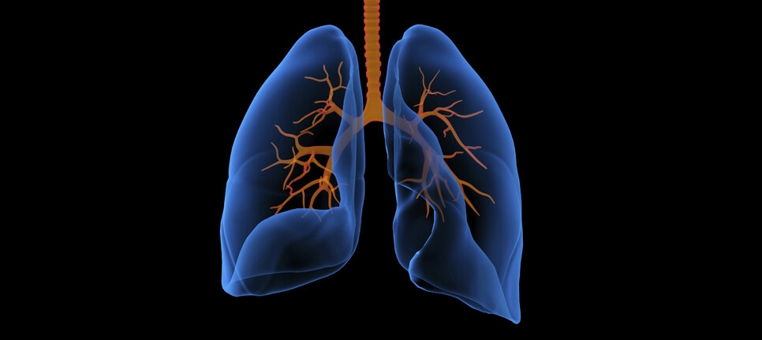
Key factors that determine the intensity of Lung Cancer
By Guney

Slide 2


Objective
The goal of the project was to identify the critical factors that significantly impacted how serious the patient's lung cancer was. Develop a model that can predict the crucial factors that will have the biggest effects on lung cancer progression.
The model can then be applied to help those whose genes or way of life put them at risk for developing lung cancer or lessen the intensity of the cancer as well as provide information that can help prevent lung cancer from ever occurring in the first place.

Slide 3


What is Lung Cancer?
When a malignant tumour begins in the lung. In the early stages, you sometimes don’t get any symptoms but after a while you may develop a cough that doesn’t go away, as well as coughing up blood and changes in your breathing.
There were more than 2.2 million new cases of lung cancer in 2020
Cancers that accounted for the largest proportion of the economic cost worldwide included tracheal, bronchus and lung cancer (15.4%, $3.9 trillion)

Slide 4





Causes of Lung Cancer
Genetics
Smoking
Air pollution
Lung Disease
Occupational hazards

Slide 5
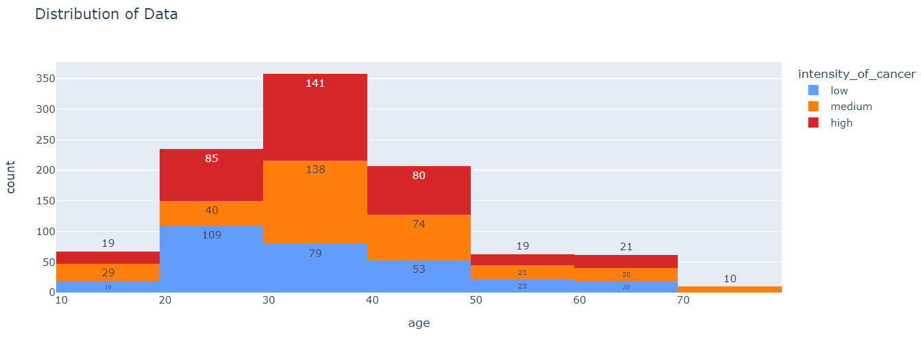
Dataset & Data Distribution
The study includes patients that were diagnosed with lung cancer in China.
Most individuals with lung cancer of high severity are reported to be between the ages of 20 and 49.
The intensity of lung cancer is quite evenly distributed between 50 and 69 years old.

Slide 6


Data Cleaning
The dataset : 1000 rows and 25 columns
Dropped the patient_id column and lowercased all the column headers
Mapped the target column with numbers to replace low, medium and high intensity levels

Slide 7
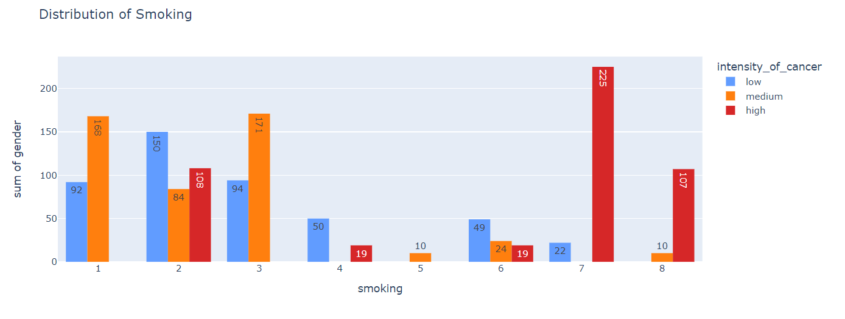


Data Exploration (Smoking)
The columns are ranked from 1 (very low) to 9 (very high)
Most patients who smoke at a 7 or 8 level have high intensity of lung cancer
108 patients with smoking level 2 are ranked high in lung cancer intensity
Overall, it seems clear that smoking does have an impact on the severity of lung cancer.

Slide 8
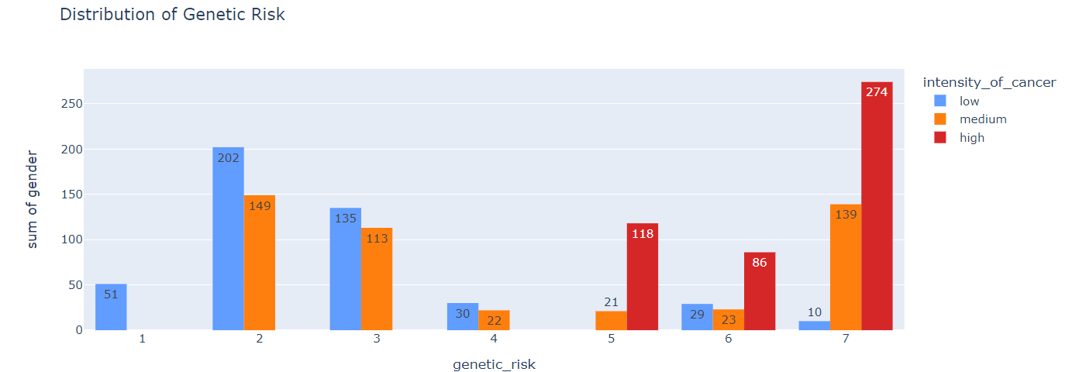

Data Exploration (Genetics)
A stronger correlation between the level of genetic risk and intensity of lung cancer than smoking
All the patients with high intensity of cancer have a genetic risk of 5 or above. No patient with a level of 8 or 9 genetic risk

Slide 9
Feature Selection
Target : Intensity of Lung Cancer | Definition
Low | Cancer is in the early stages, and it has localised in a small area of the lung. So, treatment may be to remove the affected tissue.
Medium | Cancer has spread beyond the initial area of the lung and may have affected the lymph nodes. Treatment combined may be surgery, radiation therapy, chemo to target the cancer cells and try to prevent further spread.
High | This means cancer has spread to other parts of the body such as liver, brain which is considered advanced. Treatment may include immunotherapy or palliative care to manage the symptoms and improve the quality of life for the patient as much as possible.

Slide 10
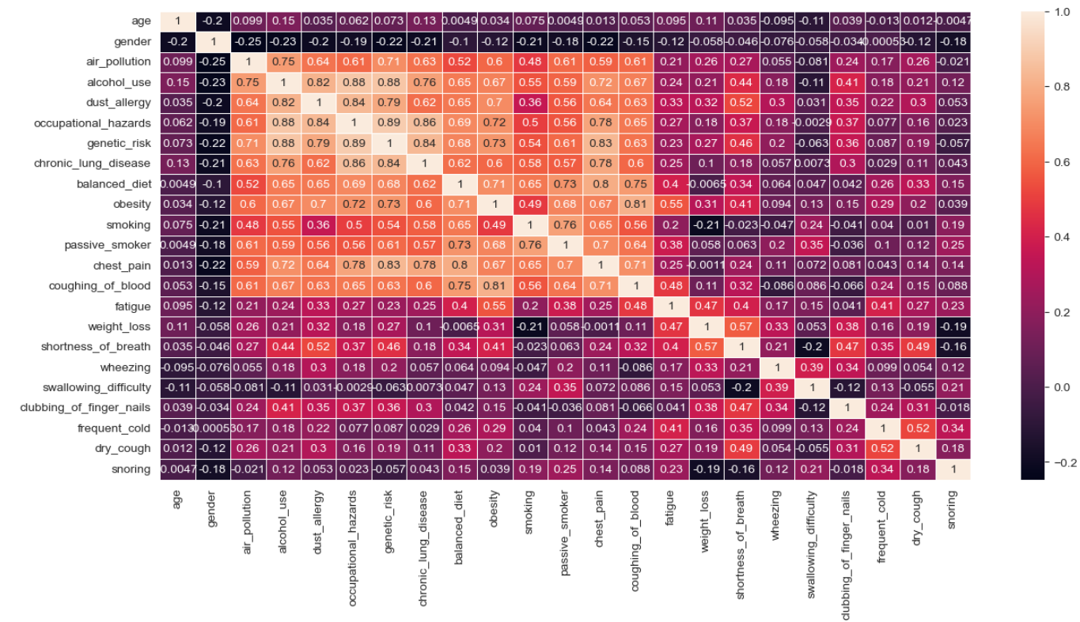
Correlation Matrix & Modelling
A strong signal overall
Correlation between categorical variables : Genetic risk and Occupation hazard - 0.89 Genetic risk and Alcohol use - 0.88 Chronic lung disease and Occupational hazard - 0.86

Slide 11



Classification models
Balance of Classes
Logistic Regression
Intensity of Cancer | Count
High | 365
Medium | 332
Low | 303
Decision Tree
The target variable is well-balanced in the dataset, which is advantageous and can lessen bias against one class.
Random Forest

Slide 12



Model Evaluation
Model | Accuracy | Precision | Recall
 | 0.96 | 0.96 | 0.95
 | 0.97 | 0.97 | 0.97
 | 0.93 | 0.93 | 0.93
Overall, Decision tree performed the best in all areas.
Recall is a valuable indicator in this model since it helps avoid misdiagnosing individuals with low intensity lung cancer when they might have medium or high-intensity lung cancer.

Slide 13


Limitations
Very small dataset and simple
Gender wasn’t specified only labelled as 1 or 2 which wasn’t clear
Lack of Diversity/Representativeness
The ranks of each columns are subjective and unclear

Slide 14


Summary
Investigated the many significant factors that may influence the seriousness of lung cancer and develop a model using this information.
Used 3 classification models with the best model being Decision Tree.
This model can therefore be used as a form of preventive strategy to aid those who are developing lung cancer of a more severe nature or possibly even to offer guidance on how to avoid lung cancer altogether.

Slide 15

Thank you for listening

